Slide 1
Making Classroom collaboration meaningful
Kelley Anderson, MA CCC-SLP
STEM Launch K-8

Slide 2
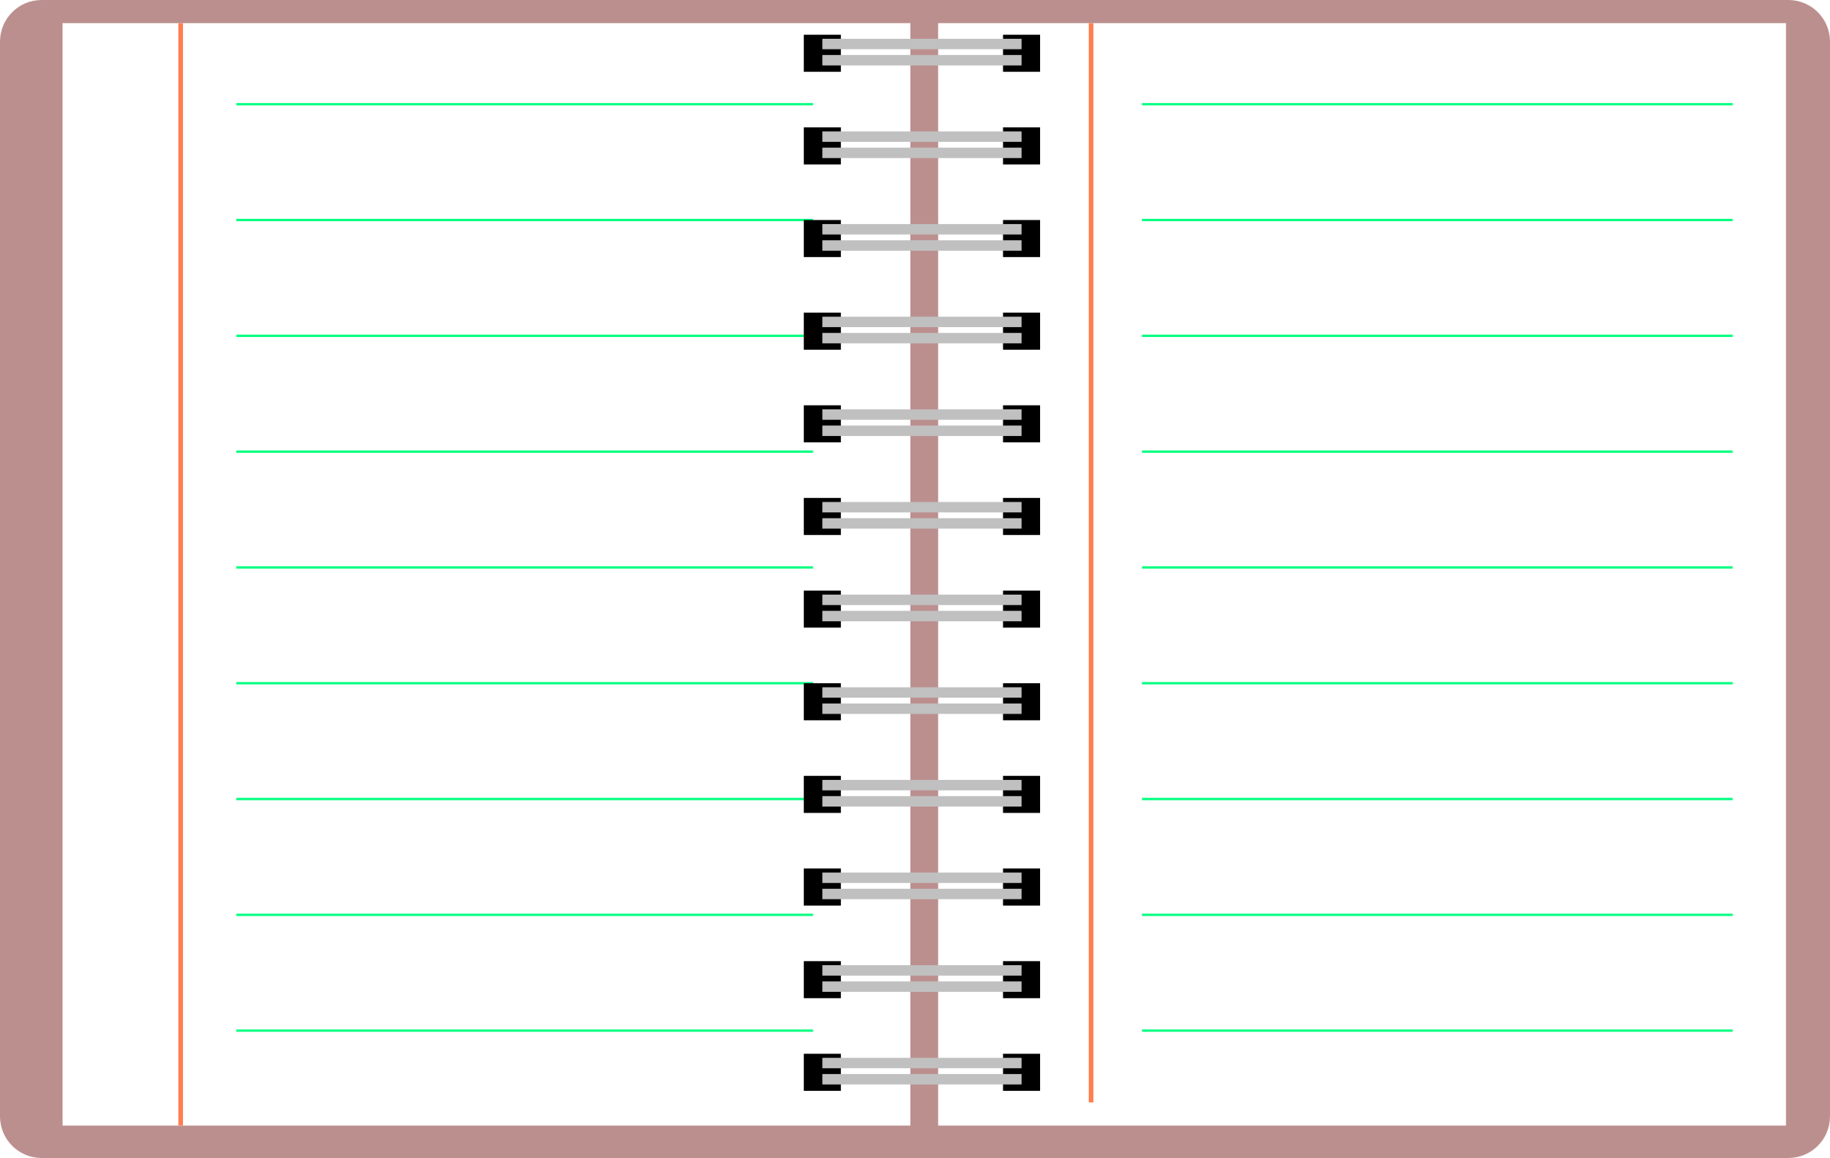
agenda
Introduction
Collaboration defined
Presenter background: In the beginning
Learning curve: Mistakes were made
It takes a Village: relationships and trust
15 minute break
Going into the classroom and meaning business
You don’t have to be there to be there
Writing goals (on which) to hang the knowledge hat (on)
Grammar…it just needed to be said
Mini Lessons
Q & A
Contact information

Slide 3
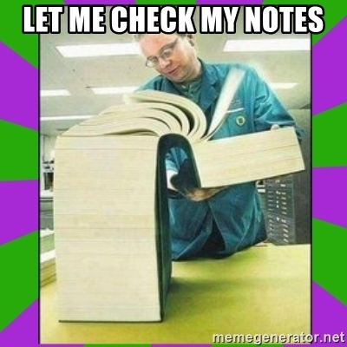
Introduction

Slide 4
Collaboration
Collaboration is defined as the action of working with someone to produce or create something.
To work jointly with others or together especially in an intellectual endeavor.
The situation of two or more people working together to create or achieve the same thing.

Slide 5
Background: who am i?
Kelley, The Scientist
Unexpected undergraduate and graduate work
Sarasota Florida- Middle School
Indianapolis Indiana- Elementary School
Broomfield Colorado- Thornton Colorado
Elementary AND Middle school
K-8 STEM

Slide 6
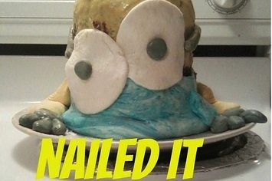
Learning curve: mistakes were made
I am not an expert
Braden Welborn (3/14/2012)
“Teacher collaboration- when it’s good, it’s very good, but when it’s bad, it’s horrid.”
State testing and the need to keep students in the classroom
Push-in-Pull out
Planning to be prepared

Slide 7
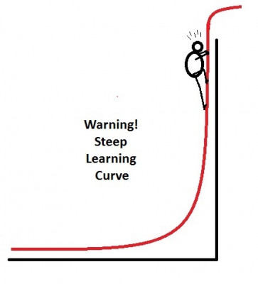
Learning curve: mistakes were made
Balancing teaching and supporting
“Together we are Better”
Sakash and Rodriguez-Brown (1995)
At-risk students who remain in mainstream classrooms with instructional support achieve at higher levels than peers who receive instruction in a pull-out model
Cook and Friend (1995)
Student’s motivation increases in mainstream classrooms when they are engaged in meaningful learning

Slide 8
What I discovered
Reading Comprehension skills
Fluent, low comprehension
Non-fluent, low comprehension
Non-fluent, decent comprehension
Writing skills…uh boy
What’s missing?

Slide 9
Grammar to the rescue!

Slide 10
Article + noun + verb
What’s a noun?
Person, place, thing, idea
What’s a verb?
Action
The cats ate.

Slide 11
But there’s more
Nouns have functions
They are subjects, and objects
They have plurality and possession
Verbs have functions
They tell time
They have voice

Slide 12
It’s complicated…

Slide 13
Timothy Shanahan, University of Illinois
“There is a lot of evidence showing the importance of grammar in reading comprehension. Studies over the years have shown a clear relationship between syntactic or grammatical sophistication and reading comprehension; that is, as students learn to employ more complex sentences in their oral and written language, their ability to make sense of what they read increases, too.”

Slide 14
Rhyming and timing
Nursery Rhymes and songs
Learn new words
The repeated rhymes help children remember words and the individual sound units-phonemes
Understanding how words are formed
Teaches how language works
Helps build memory
Help pave the way for a love a books

Slide 16
It takes a village: Relationships and trust
We all want the same thing:
Teachers and SLPs want students to be happy and successful
Students need all hands on deck
With repetition, students still miss the point
SLPs need to know who is teaching their students and teachers need to know the SLPs in their buildings
TRUST and BUY-IN
SLPs need to know that accommodations are being used with FIDELITY
Teachers need to trust that we, SLPs will do what we say we will do

Slide 17
Break Time: back in 15 minutes

Slide 18
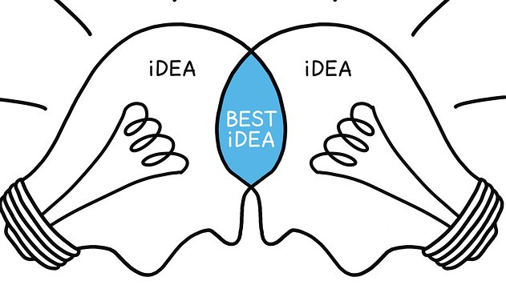
Going Into the classroom and meaning business
Time is important
Engagement must be meaningful
Can include the bright and the special
Come prepared…as prepared as you can
Most beneficial
One teach-One observe mixed with Team teaching

Slide 19
You don’t have to be there to be there
Modeling the language for both the teacher and the students
Give more than enough examples
Leave the teacher and students with verbiage that’s works in their particular classrooms
A wall chart or poster
Tape up bullet points

Slide 20
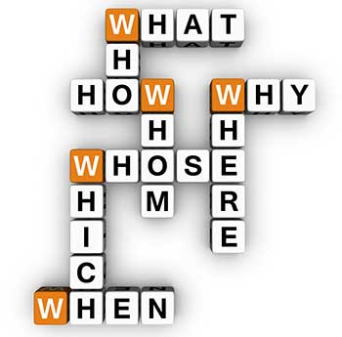
Ask the right questions
Students will tell you what they don’t understand…if you’re asking the right questions
Repetition to us does not equate understanding from them

Slide 21
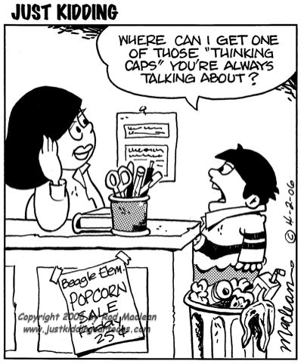
Writing goals (on which) to hang the knowledge hat (on)
Trying to get the biggest bang for the buck
Don’t want to reinvent the wheel
How can I support reading and writing efficiently?
Can it flow from classroom to therapy room and vice versa?

Slide 22
Grammar…it just needed to be said
Meaningful to students
Alphabet
Letters
Vowels
Consonants
Words
D-o-g
Sentences
The dog runs.
Paragraphs
Pages
Chapters
Books

Slide 23
Words mean everything
Vocabulary
Word categories
Parts of speech

Slide 24
Mini lessons
Started with the very basic
Use items in the classroom and actions of students
Catered to each grade level
Build from Kindergarten level
Add parts of speech to build longer sentences
10-15 minutes
Interactive
Use students names in examples
Allow speech students to respond

Slide 25
Wrapping up
Students need teachers and SLPs to work together for them
It’s a delicate dance between exposure to curriculum and working toward IEP goals
Collaboration is key
Collaboration requires trust and buy-in
Must determine best bang for the buck
Consider grammar

Slide 26
Questions, Comments, concerns

Slide 27
Thank you!
Kelley Anderson, MA CCC-SLP
Kelley.s.Anderson@adams12.org Work
andersonkelley@yahoo.com Private
720.972.7088 Work
9450 Pecos Street
Thornton, CO 80260

